Slide 1
Training for Municipal Clerks
March 2024
Data, Research, and Vital Statistics
Theresa Roberts, Supervisor, and Deputy State Registrar
Melissa Boynton, Electronic Data Solutions Supervisor
Rebecca Ashley, Marriage Representative
Joseph Terry, Birth Representative

Slide 2

Resources
Staff listing https://www.maine.gov/dhhs/mecdc/public-health-systems/data-research/vital-records/edrs/medical-certifiers.html
Vital Records Public Forms https://www.maine.gov/dhhs/mecdc/public-health-systems/data-research/vital-records/forms/index.shtml
Access to DAVE https://www.maine.gov/dhhs/mecdc/public-health-systems/data-research/vital-records/edrs/medical-certifiers.html
Website for Municipal Clerks https://www.maine.gov/dhhs/mecdc/public-health-systems/data-research/vital-records/edrs/medical-certifiers.html
Online Indexes https://docuware.maine.gov/DocuWare/Platform/WebClient/

Slide 3
Responsibilities of the Department
General Section, pages 5-8
Preserves all certificates, records, and other reports returned to the State Registrar;
Has general supervision of Title 22, Title 19-A, and 10-146 Department rules relating to the registration of vital statistics;
Directs, supervises, and controls activities of all persons engaged in the operation of the system of vital statistics;
Conducts training programs to promote uniformity of policy and procedures throughout the State in matters pertaining to the system of vital statistics;
Monitors the accuracy, completeness, and validity of all information returned to the Data, Research, and Vital Statistics (DRVS) office.
Prescribes and furnishes forms with instructions necessary to the administration of the vital statistics system or prescribe other means of transmission of data that accomplish the purpose of complete and accurate reporting and registration.

Slide 4
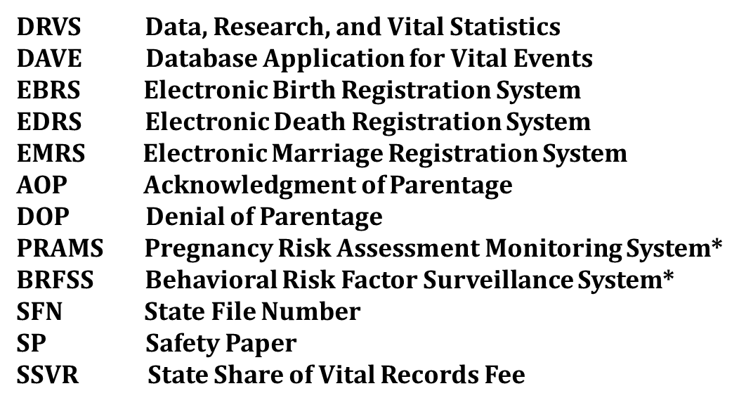
Acronyms
*PRAMS is a population health surveillance system to improve the health of birthing people and infants by collecting information on why some babies are born healthy and some are not.
*BRFSS is the world's largest, on-going telephone health survey system, tracking health conditions and risk behaviors throughout the United States and its territories.

Slide 5
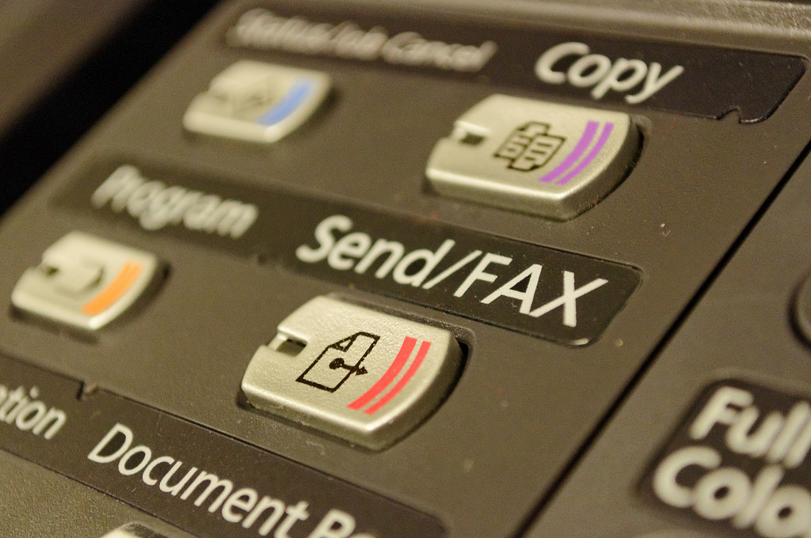
Faxing Vital Records
General Section, page 10
Faxes are secure provided that the Department or municipal clerk has verified the agency, business, or institution to which they are faxing the information. One of the reasons for fax security as opposed to the security of other Internet or mobile-based communications is that fax machines communicate via phone lines, not the Internet. Phone lines are more difficult to compromise than public internet and Wi-Fi connections, although, the fax may be intercepted, and the record may not go where intended.
The Department does not normally permit or allow any records, whether certified or non-certified, to be faxed to any individual, business, or institution, but there may be occasions on a case-by-case basis when a customer needs a record faxed to the airport or cruise line for travel, a new job, or housing. Municipal clerks may use their discretion for these types of cases. Prior to faxing any information, please be sure that an application, identification, proof of lineage, or a direct and legitimate interest (if applicable) has been provided and payment has been arranged

Slide 6
Verification Procedure
General Section, page 10
If a vital record is requested, and the municipality does not have the record on file or is questioning the information on a vital record, municipal clerks may fax a verification request to the Department. The verification process has been established to ensure municipal clerks receive the quickest response possible from vital records staff.
Examples of the times when a verification request should be faxed to the Department are when there is a missing file date, spelling of the registrant's (or parent's) names on a record if there has been an adoption, or to check if a correction or a legal name change has been applied to the record.
If a customer is waiting and needs immediate assistance, please indicate so on the verification form. If a response is not provided within a reasonable amount of time, please contact Kristin Sprague at (207) 287-3100 or kristin.sprague@maine.gov.
The verification form will still need to be completed to account for services provided by the Department. Please do not leave voicemails for other vital records staff in the Department for they will only be forwarded to Kristin for a response.
The verification form and instructions may be found on the Department’s website for clerks at https://www.maine.gov/dhhs/mecdc/public-health-systems/data-research/vital-records/edrs/medical-certifiers.html
FAX # 287-1093

Slide 7
True Attest Copies
General Section, page 11
Periodically, municipal clerks will be asked to mail a “true attest copy” or “attested” of a birth, marriage, or death record to either the Department or another municipality.
To make a true attest copy of the record, simply photocopy the record onto plain white paper and type or write the statement “True Attest Copy”. The issuing officer will need to print and sign their name and title under the statement and provide the date the copy was made. Place the municipal seal next to the issuing official’s signature. For records that are a full page, the statement and signature should be done on the back of the record where it will not become part of the record when issued onto safety paper.
Example of a True Attested Copy
True Attest Copy
Signature Christine Wolfe
Name and title Christine Wolfe, Municipal Clerk
City/Town Town of Freeport
Date: 03/19/2023
(Emboss or place municipal seal by the true attest statement)
When issuing vital records from an attested copy, please be sure to cover the statement before issuing certified copies. A true attested copy is never notarized, it is only signed by the municipal clerk or the clerk’s authorized staff.

Slide 8

Unincorporated Places
General Section, page 11
Title 22 § 2703 specifies;
When a birth occurs in an unincorporated place, it must be reported to a municipal clerk as specified by the state registrar and must be recorded, or registered in the electronic birth registration system, by the municipal clerk to whom the report is made. All such reports and records must be forwarded to the state registrar.
  Title 19-A §651(1) specifies;
  If there is no clerk in the place of their residence, the notice of intentions must be filed with the clerk of an adjoining municipality.
Notes:
DRVS has compiled a list of unincorporated places and municipalities where a vital record should be registered. Please contact DRVS if you have any questions.

Slide 9
United States Department of Veteran Affairs (TOGUS)
& Veterans Copies of Vital Records
General Section, page 11
Municipal clerks may provide free certified copies of a public birth, death, or marriage record (see below paragraph) to applicants who indicate the requested record is to be used in determining eligibility for Veterans Administration benefits. The statute does not limit the number of free copies to just one. All certified copies issued for VA benefits must be stamped "FOR VA BENEFITS ONLY". In the event the birth, death, or marriage is considered a restricted record, please refer applicants to the Department to obtain a fee copy.
Public Record Defined. After 75 years from the date of birth for birth certificates, after 50 years from the date of death for fetal death certificates, after 25 years from the date of death for death certificates, after 50 years from the date of marriage for marriage certificates, and after 50 years from the registration of domestic partnerships, any person may obtain noncertified copies of these vital records under the department's rules. Certificates and records of birth, marriage, and death, including fetal death, created before 1892 are open to the public without restriction. All persons may purchase a copy on municipal letterhead, or a noncertified copy of a vital record created before 1892.
DAVE does track when a free veteran's copy has been issued when the service (birth veteran, death veteran, and marriage veteran) is selected. Municipal clerks may need to save any overrides if another copy of the same record is requested for veterans' benefits.
Notes:
Certificates of live births, deaths, and fetal deaths occurring at the federal facility, known as Togus, are filed directly with the Department in the DAVE system. Prior to the DAVE system, the Department forwarded paper copies of all live births, deaths, and fetal deaths received, to the clerk of the municipality where the parents of the child resided or the municipality where the decedent resided.

Slide 10

Citizenship and Naturalization
General Section, page 12
https://www.uscis.gov/citizenship/learn-about-citizenship/citizenship-and-naturalization
Deciding to become a U.S. citizen is one of the most important decisions an immigrant can make. United States citizenship is the status of being a citizen of the United States. It can be acquired through birth within the U.S. or its territories, or through a legal process known as naturalization. Being a U.S. citizen comes with many rights and responsibilities, including the right to vote, the ability to hold certain government jobs, and the ability to sponsor family members for immigration. Additionally, U.S. citizens are protected by the laws and government of the United States and can travel with a U.S. passport.
Depending on the situation, there may be different ways to obtain citizenship.
Naturalization is the process by which U.S. citizenship is granted to a lawful permanent resident after meeting the requirements established by Congress in the Immigration and Nationality Act (INA).
Acquisition of citizenship is obtained through U.S. citizenship parents either at birth or after birth, but before the age of 18.
For more information, see the USCIS Policy Manual Citizenship and Naturalization Guidance at Volume 12 - Citizenship and Naturalization | USCIS.

Slide 11
U.S. Citizens Born Overseas
General Section, page 12
https://travel.state.gov/content/travel/en/international-travel/while-abroad/birth-abroad.html
The birth of a child abroad to a U.S. citizen parent(s) should be reported to the nearest U.S. Consulate or Embassy as soon after the birth as possible.
The application must be supported by evidence to establish the child’s U.S. citizenship. Usually, the following documents are needed:
The child’s birth certificate.
Evidence of the U.S. citizenship of the parent(s) such as a certified copy of a birth certificate, U.S. passport, or Certificate of Naturalization or Citizenship.
Evidence of the parent's marriage, if applicable; and
Affidavit(s) of the physical presence of the parent(s) in the United States.
Each document should be certified as a true copy of the original by the registrar of the office that issued the document. Other documents may be needed in some cases. Contact the nearest U.S. Embassy or Consulate for details on what evidence is needed. An official list of embassies from the U.S. Department of State may be found at https://www.usembassy.gov/.
Department of State
Passport Vital Records Section
44132 Mercure Cir.
PO Box 1213
Sterling, VA 20166-1213

Slide 12

Homebirths
Birth Section, page 12
Proof of Pregnancy
Proof of Place of Birth
Other Supplemental Information Proving Home Birth
Notes:
If a child is delivered outside an institution, not in a moving conveyance, and unattended by a certified nurse midwife, professional or licensed midwife or other attendant, the parents must request worksheets directly from the Department or the municipality in which they reside. The VS1-C Parent Worksheet and the VS1-D Medical Worksheet worksheets must be completed, signed, and the parents must verify the accuracy of the personal and medical data on the worksheets. In addition to the worksheets, at least two forms of documentary evidence must be provided to support proof of pregnancy and the fact that the mother gave birth in the State of Maine. Examples of acceptable documentation are provided below.

Slide 13

Births Occurring En Route
Birth Section, page 12
When a birth occurs en route to a hospital, institution or birthing facility or is attended in the facility immediately following the birth, must be completed by the hospital, institution, or birthing facility in the EBRS.
Notes:
The place of birth for a birth that occurs in a moving conveyance is determined as specified below:
When a birth occurs in a moving conveyance within the United States and the child is first removed from the conveyance in Maine, the birth must be registered in Maine and the place where the child is first removed is considered the place of birth.
When a birth occurs in a moving conveyance while in international waters, air space, or in a foreign country or its air space and the child is first removed from the conveyance in Maine, the birth must be registered in Maine although it is no evidence of United States citizenship. The birth record must show the actual place of birth to that extent as can be determined.

Slide 14

Hospital’s Responsibility
Birth Section, page 9
The hospital, institution, or birthing facility, or the person authorized by the hospital, institution, or birthing facility, must obtain the personal and medical data, prepare the certificate, and certify by signature or by the electronic process that the child was born alive at the place and time and on the date stated and file the certificate within 2 days after the child was born.
All physicians, informants, and other persons having knowledge of knowing the facts, must supply, upon the prescribed forms provided by the Department, any information they possess regarding any live birth. If the parents refuse to cooperate in the filing of the birth record, the hospital must still prepare a record for the child. If necessary, information to prepare the birth record may be obtained from the medical records file
Notes:
The personal, parental, and medical data must be obtained by the completion of the parent and medical worksheets prescribed and furnished by the Department to prepare the birth record. The VS1-C Parent Worksheet and the VS1-D Medical Worksheet may be found under the “Forms/Print Forms” tab in the Electronic Birth Registration System (EBRS). Discuss the child’s name at birth, gender, SSN#, marital status, and AOP completed at the hospital.

Slide 15

Responsibilities of Municipal Clerk’s
General Section, pages 13-19
Keep a chronological record of all live births, marriages, deaths, and fetal deaths reported to the municipal clerk and preserve all records.
Enforce laws and rules related to access and disclosure of vital records.
Transmit records to the state registrar and other entitled municipalities.
Process, review, file, and issue copies of vital records.
Issue marriage licenses and disposition permits.
Maintain approved applications for one year.
Assist residents with completing forms and providing instruction.
Report SSVR (monthly, quarterly, or semi-annually.
Track safety paper numbers in DAVE or on applications.
Notify DRVS when the clerk leaves or is new, or if the municipality address has changed.

Slide 16

Enforce Laws and Rules
General section, page 13
It is the municipal clerk’s responsibility to enforce all the laws and rules of the Department related to the registration of vital statistics. In general, this means that municipal clerks are responsible for ensuring that records are properly filed, issued, and preserved as required by law. If a municipal clerk becomes aware of any violations of the law, please notify the Department immediately.
The links below contain the most recent language in law and rule:
Title 22: PART 6, BIRTHS, MARRIAGES, AND DEATHS https://legislature.maine.gov/statutes/22/title22ch0sec0.html
Title 19-A: DOMESTIC RELATIONS, PART 2, MARRIED PERSONS https://legislature.maine.gov/statutes/19-A/title19-Ach0sec0.html
Title 19-A: DOMESTIC RELATIONS, CHAPTER 61: MAINE PARENTAGE ACT https://legislature.maine.gov/statutes/19-A/title19-Ach61sec0.html
DEPARTMENT RULES: 10-146 OFFICE OF DATA, RESEARCH AND VITAL STATISTICS (Chapter 1 through Chapter 16) https://www.maine.gov/sos/cec/rules/10/chaps10.htm#146
Notes:
Most breaches of the law are not deliberate or willful, but due to ignorance or simple negligence. Persuasion and education will usually serve to correct most problems. However, municipal clerks may occasionally have a chronic problem or become aware of a serious breach of the law. The Department will help with enforcement problems and will file a complaint with the District Attorney or the appropriate State Licensing Board if necessary.

Slide 17
Formats of Vital Records
General Section, page 14
Electronic records. The Database Application for Vital Events, known as DAVE, contains 3 modules:
Electronic Birth Registration System (EBRS)- Births from Sept of 1995 to Present
Electronic Death Registration System (EDRS)- Deaths from Jan of 2011 to Present
Electronic Marriage Registration System (EMRS)- Marriages from Jan of 2017 to Present
Any birth, death, or marriage record in the above timeframes must be issued directly from the system. All corrections/amendments done to vital records will be done electronically within the system. The most current version of the record must be issued.
Paper Records. 1892 to DAVE (see above). Vital records from 1956 to DAVE must be issued from the original paper record on file, when possible (unless municipalities have scanned the originals). Please avoid issuing abstracts for vital records in this timeframe. Please see pages 28 - 31 for more information on issuing vital records and typing an abstract of a vital record.
Records prior to 1892 are located at the municipal level only. Records must be issued as a non-certified copy or recorded on municipal letterhead. Copies of records prior to 1892 must never be issued on safety paper. See an example of how to issue a copy of a record occurring prior to 1892 from an old book on page 31.
Notes:
Vital records occurring outside of the State of Maine should never be filed within a municipality and a copy should never be issued. The law specifies which records the Department and municipalities are to keep. Other States and Foreign countries have their own vital statistics systems and laws. Municipalities should only have vital records that occurred in their municipality (place of event or residence):

Slide 18

Formats of Vital Records (continued)
General Section, page 14
Who can issue a birth, death, fetal death, or marriage record?
Births should be filed in the municipality where the birth occurred and the mother’s residence at the time of birth.
Deaths should be filed in the municipality where the death occurred and the decedents' residence at the time of death.
Marriages should be filed in the place of marriage (there is a gap for some marriages) and one or both parties' residence(s) at the time of marriage.
The only exception to filing a record occurring outside of the State of Maine is when foreign-born children are adopted through a Maine court.
Notes:
Foreign Born. In the case of a Maine certificate of birth being established for a person born in a foreign country, a copy of the certificate must be provided to and must be maintained on file by the clerk of the municipality where the adoptive parents resided on the date of the adoption. Please refer to the birth portion of the municipal clerk’s manual on adoptions for more information.

Slide 19
Transmitting and Distribution of Paper Records
REGISTRAR AT PLACE OF BIRTH |  |  |  |  |  |  |  |  |  |  |  |  |  |  | State of Maine Department of Health and Human Services CERTIFICATE OF LIVE BIRTH ORIGINAL - STATE
 | REGISTRAR AT PLACE OF RESIDENCE |  |  |  |  |  |  |  |  |  |  |  |  |  |  | REGISTRAR AT PLACE OF BIRTH
 |  |  |  |  |  |  |  |  |  |  |  |  |  |  |  |  | REGISTRAR AT PLACE OF RESIDENCE
 |  |  |  |  |  |  |  |  |  |  |  |  |  |  |  |  |  | NOT A LEGAL COPY
 |  |  |  |  |  |  |  |  |  |  |  | MEDICAL SECTION |  |  | ===>
DEATHS
 |  |  |  |  |  | COPY: PLACE PERMIT ISSUED
 |  |  |  |  |  |  |  |  | COPY: PLACE OF RESIDENCE
 |  |  |  |  |  |  |  |  |  |  | COPY: PLACE OF DEATH
 |  |  |  |  |  |  |  |  |  |  |  | ORIGINAL: STATE State of Maine Department of Health and Human Services CERTIFICATE OF DEATH
MARRIAGES
 |  |  |  |  |  |  |  |  |  |  |  | State of Maine Department of Health and Human Services LICENSE AND CERTIFICATE OF MARRIAGE ORIGINAL – STATE DO NOT ISSUE ORIGINAL
 |  |  |  |  |  |  |  |  |  | COPY: PLACE OF ISSUE
Notes:
Prior to electronic registration systems, municipal clerks were required to make weekly reports or “returns” to the Department and residence municipality. The paper process for reviewing, accepting a record for filing, and forwarding a paper vital record occurring in a municipality to the State Registrar and the residence municipality has been discontinued. All registrations are now done electronically. There may be times when a homebirth or fetal death form is sent to the municipality, which should immediately be forwarded to the Department to be entered into the electronic system. Clerks may also find a paper vital record that was never forwarded to the Department or the residence municipality, which will need to be forwarded to the correct place of filing. Please see examples of the distribution of copies below.

Slide 20
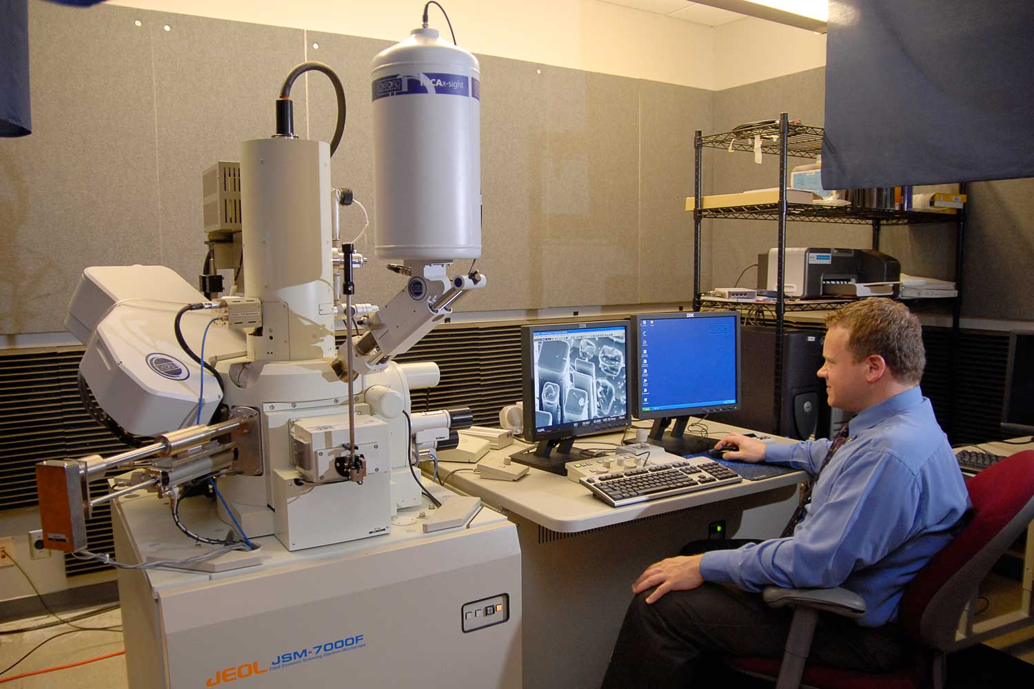
Preservation & Conservation
General section, page 16
Vital records are permanent records and must be preserved carefully. Original, paper records must be handled in accordance with guidelines designed to protect the physical integrity and condition of the records.
Preserve records by placing them in binders or containers made for the purpose to protect and preserve the records from deterioration, mutilation, loss, or destruction.
Keep paper records in chronological order by type of record and date of the event so they are easy to find when requested.
File records back immediately after they have been issued to avoid any possible damage or misplacement of the record.
"Hands-on" access or inspection of original, paper-based records or indexes should not be permitted to genealogists if there is an alternative method that may be used.
Each municipality should have a dedicated storage area, or a fireproof safe/vault, to file and preserve all vital records. Access to the dedicated area or vault where vital records are stored should only be permitted to the municipal clerk, deputy clerk, or assistant clerk, who is authorized to issue vital records.
Notes:
The ideal conditions for storing paper records that are in regular use are a constant temperature of about 65 degrees F and a relative humidity of about 40 percent. Keep records out of hot attics, damp basements, and other dirty and dusty places. Watch for bookworms, silverfish, and other insects, which eat paper. The enemies of paper are heavy use, heat, moisture, dust, insects, and extrinsic acidity.

Slide 21

Preservation & Conservation (continued)
General section, page 16
Vital records are permanent records, and municipal clerks should protect them from hazards as much as possible. Municipal clerks should not attempt to repair damaged records themselves. Above all, do not use cellophane tape to repair tears. It soon becomes brittle and peels off leaving a permanent brown stain on the record. Minor tears may be repaired with mending tissue and library paste, only if it is possible to do so without covering information on the record, or with the special transparent book-mending tapes.
Very old books and records that are damaged should receive expert attention. Old records may be microfilmed, scanned, or photocopied to produce working copies that may be used while the originals are safely stored in the vault. Broken bindings can be replaced, and damaged sheets laminated. This is rather expensive work and will need to be considered in the municipalities budget. Please contact the State Archivist with any questions related to record conservation at:
Maine State Archives
17 Elkins Ln, Augusta, ME 04333-0084
(207) 287-5790
maine.archives@maine.gov

Slide 22

Retention of Paper Records
General section, page 17
Paper vital records may not be destroyed or otherwise disposed of by any local government official, except as provided by the records retention schedule established by the State Archivist. Records that have been determined to possess archival value must be preserved by the municipality. Contact the records management services at the Maine State Archives for guidance on the disposition of older ancillary records such as premarital medical examination forms, waivers of premarital medical examinations, and waivers of the 3-day waiting period between the filing of marriage intentions and the issue of license. It is recommended that a record be made, by year, of the items disposed of and the nature of the disposition.
Many municipalities are running out of room to store paper records and are thinking of alternate ways for storage or replication of records. Please contact the Department for more information about the approved electronic methods or systems. All methods or systems must be approved by the Department before implementation.
Notes:
10-146 Department Rule, Chapter 11 https://www.maine.gov/sos/cec/rules/10/chaps10.htm#146 states “when an authorized reproduction of a vital record has been properly prepared, by photographic, electronic, or other processes, by the State Registrar and when all steps have been taken to ensure the continued preservation of the information, the record from which such authorized reproduction was made may be disposed of by the State Registrar. Such record may not be disposed of, however, until the quality of the authorized reproduction has been tested to ensure that acceptable certified copies can be issued and until a security copy of the document has been placed in a secure location and removed from the building where the authorized reproduction is housed. Such security copy shall be maintained in such a manner to ensure that it can replace the authorized reproduction should the authorized reproduction be lost or destroyed.”

Slide 23

Integrity of Vital Records
General Section, pages 17-18
Municipal clerks must prevent improper treatment or use of vital records to the best of their ability. Courts, governmental agencies, and others depend upon the integrity of vital records for important purposes. The law provides that these records are prima facie evidence, if not amended or delayed. This means that the statements on the record can be accepted as correct by a court or other agency and they will stand unless they are challenged. Vital Records information is often used to determine legal or property rights and eligibility for other important benefits. It is essential that persons who make judgments that require reference to vital records data be able to trust them.
Do not permit any records to be altered in any way except by one of the methods specified in the law and as directed by the Department. Please call and verify with the Department, or refer to the other portions of the manual, to ensure the correction procedure was done by regulation and was not falsified or altered deceitfully.

Slide 24

Fraud
General Section, page 18
Require identification for all individuals requesting vital records.
Establish a phone policy for not releasing information over the phone.
Limit access to data and vital records (authorized personnel only).
Protect personally identifiable information such as written requests and applications. Maintain for one year.
Request validation of reports and documents submitted before releasing a vital record or issuing a marriage license.
Follow “Disclosure of Vital Records” laws (Title 22 §2706)
Control of documents (electronic and hard copy)
Preservation of vital records (including a disaster plan for recovery of vital records)
Mark the birth records deceased (if a resident of your municipality)
Track safety/security paper and keep them in locked draws/cabinets
This Photo by Unknown Author is licensed under CC BY

Slide 25
State Share of Vital Records
General Section, page 34
The State Share of Vital Records (SSVR) fee is the amount to be paid by municipalities to the Department based upon (1) the actual number of certified copies and additional certified copies of the same records requested at the same time relating to birth, death and marriage records issued by a municipality; (2) the actual number of Disposition Permits of Human Remains issued by a municipality; (3) and the actual number of marriage licenses issued by a municipality.
The SSVR is assessed upon Maine municipalities by the Department for services including, but not limited to, services, supplies, technology, health data and vital statistics, and paper. The items are subject to the municipal service fee and the fees are as follows:
Certified copies of birth, death, or marriage - $2.00
Additional certified copies of birth, death, or marriage - $.40
Marriage Licenses - $4.00
Disposition of Human Remains Permits - $6.00
Municipalities must submit their Municipal Revenue Reporting and the State Share of Vital Records Fee in a format and schedule as determined by the Department and a fillable form with calculations has been developed for this purpose.
The SSVR reporting form, instructions for completing the form, as well as the customer number list and reporting periods for municipal clerks, may be found in DAVE under the Forms/Print Forms tab. Please contact Sue Paradis at (207) 287-5471 or susan.paradis@maine.gov.

Slide 26

Break Time

